Slide 1

Spam Email Prediction Using Machine Learning
By Shubham Kushwaha

Slide 2
Outline
Introduction
Data Preprocessing
Exploratory Data Analysis
Model Selection
Model Training
Model Optimization
Deployment and Monitoring
Conclusion

Slide 3

Introduction
In today's digital age, email has become a vital communication channel for individuals and businesses alike. However, along with the benefits of email comes the persistent nuisance of spam.
Spam emails, often unsolicited and irrelevant, can clutter inboxes, waste time, and potentially expose users to scams or malware. To combat this issue, machine learning techniques have been employed to predict and filter out spam emails effectively.
Spam email prediction using machine learning is a subfield of artificial intelligence that aims to automatically identify and classify incoming emails as either spam or legitimate.
By leveraging the power of machine learning algorithms, these predictive models analyze various features and patterns within email content, headers, and metadata to make accurate predictions about the spam likelihood of an email.
The process of spam email prediction typically involves two main steps: training and testing. In the training phase, a machine learning model is constructed by using a labeled dataset that consists of both spam and non-spam (ham) emails.

Slide 4
Introduction
The model learns from these examples to recognize patterns and characteristics that distinguish spam emails from legitimate ones.
Once the model is trained, it is evaluated using a separate dataset in the testing phase. This evaluation allows us to assess the model's performance in terms of accuracy, precision, recall, and other relevant metrics.
By iteratively refining the model and repeating the training and testing process, we can enhance its predictive capabilities and ensure its effectiveness in identifying spam emails accurately.
Feature engineering plays a crucial role in spam email prediction. Various textual, syntactical, and statistical features can be extracted from email content, such as the presence of specific keywords, the frequency of capital letters, or the number of exclamation marks.
Additionally, features like sender reputation, IP address analysis, and email header information can provide valuable insights into the email's authenticity and potential spam status.

Slide 5
Introduction
One challenge in spam email prediction is the constantly evolving nature of spamming techniques. Spammers continuously adapt their tactics to evade detection, necessitating the need for ongoing model updates and the incorporation of new features.
Therefore, a robust and scalable machine learning solution is essential to keep up with the evolving landscape of spam emails.
By accurately predicting spam emails, machine learning-based approaches provide significant benefits. They help users save time and improve productivity by filtering out unwanted messages, protect against phishing attempts and malicious links, and enhance the overall security of email communication.
In this Project, we delve into the various machine learning techniques employed in spam email prediction. We explore different feature extraction methods, model architectures, and evaluation metrics commonly used in this domain.
Overall, spam email prediction using machine learning is a vital field that leverages intelligent algorithms to combat the ever-present issue of spam emails. By developing accurate and efficient predictive models, we can significantly improve email filtering, enhance user experience, and ensure the security and integrity of our digital communication channels.

Slide 6
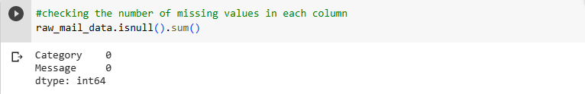
Data Preprocessing
Data preprocessing is an essential step in preparing the Spam Email dataset for analysis and building machine learning models. The following are some common data preprocessing steps for Spam Email data:
Handling Missing Values : Spam Email dataset does not contain any missing values or null entries. This means that we have complete information for all the features, allowing us to proceed with the analysis and model building without the need for imputation or data cleansing.

Slide 7
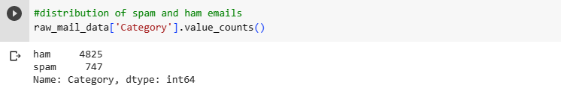
Data Preprocessing
Handling Imbalanced Data : However, one important challenge we face in our Spam Email dataset is its highly unbalanced nature. Out of the total samples, only 747 instances are labeled as spam Email, while the majority class represents 4825 Ham Email. This severe class imbalance can significantly impact the performance of our models and requires special attention during the analysis and evaluation stages.

Slide 8

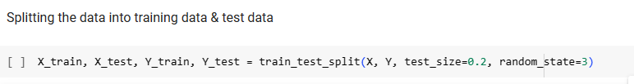
Data Preprocessing
Splitting into Training and Testing Sets : We divided our dataset into the 4 array X_train, X_test, Y_train ,Y_test where X & Y are original datasets where X contains Emails and Y contains their labels.
Here we split our dataset in 80% data which is used for training and 20% data which is used for testing. Hence X_train contains training data ane their corresponding labels are stored in Y_train , similarly Y_test contains testing data and Y_test contains its labels.

Slide 9
Feature Extraction
Here we convert the text data into meaningful numerical value because our regression model doesn’t understand text data.
For this we had imported TfidfVectorizer() which will split the repeating text in our data by providing it some value. Its parameter with min_df=1 which means the words which repeating count less than one will be ignored because we don’t required it. Second parameter is stop_word=‘english’ which means the words like ‘is’,’are’,’of’ etc doesn’t make much more sense hence ignoring that kinds of words.
Next we create an instance of the tfidfVectorizer with fit_transform method to convert our X_train data and X_train data into numerical values and stored in X_train_features and X_test_features arrays respectively.

Slide 10
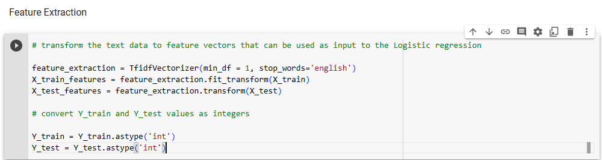
Feature Extraction
For Y_train and Y_test we don’t need to convert because they already are present in numerical format.
Next we convert the Y_train and Y_text dataset into the integer format because it is in the object format for this we use astype() method.

Slide 11
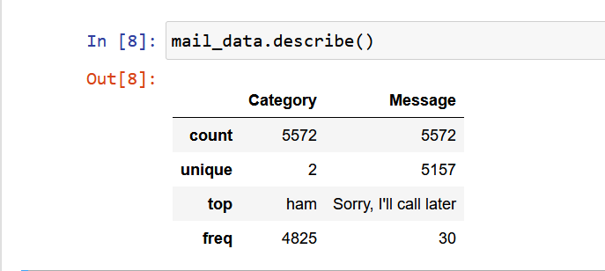
Exploratory Data Analysis
This Shows the count for our dataset in which we have 5572 category and 5572 messages in which 2 category are present which is spam and ham and 5157 messages are unique which can be useful during the training of our model. The top element of category list is ham and the top message is “Sorry, I’ll call later”.
Hence due to this we get a brief information about our dataset.

Slide 12
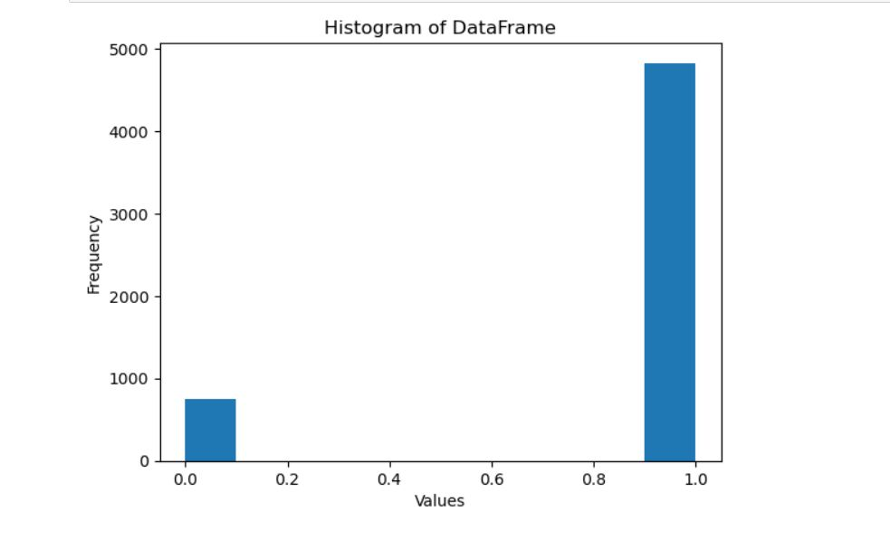
Exploratory Data Analysis
Data Visualization
Histogram Plot

Slide 13
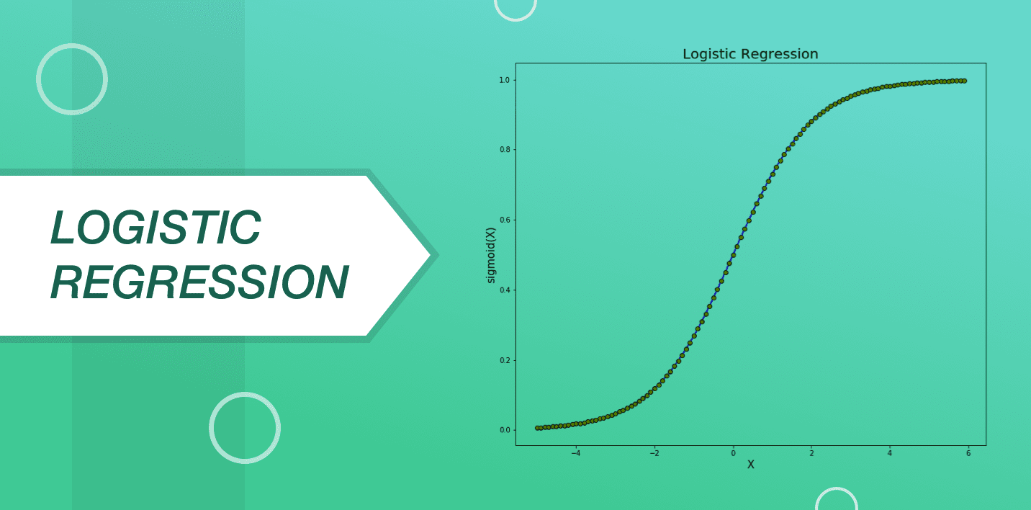
Model Selection
Logistic Regression

Slide 14
Model Selection
During the model selection process, Logistic Regression was chosen as the preferred model for the Spam Email prediction task.
Logistic Regression was selected due to its ability to handle binary classification problems effectively, which aligns well with our objective of distinguishing between Spam and Ham Emails.
Additionally, Logistic Regression provides interpretability by estimating the probabilities associated with each class, enabling us to understand the factors contributing to the prediction outcomes.
Logistic Regression is computationally efficient and performs well even with large datasets, making it suitable for our Spam Email dataset.
Another advantage of Logistic Regression is its resistance to overfitting, as it utilizes regularization techniques like L1 or L2 regularization, which can help prevent the model from fitting noise in the data.
Finally, Logistic Regression is a widely-used and well-studied algorithm with a solid theoretical foundation, providing a reliable and established approach for our Spam Email Prediction task.

Slide 15
Model Training
In the model training phase, we utilized the train_test_split function from the sklearn.model_selection module to split our dataset into training and testing sets. This function enabled us to create separate subsets of data to train the Logistic Regression model and evaluate its performance.
Next, we imported the LogisticRegression class from the sklearn.linear_model module. This class served as the implementation of the Logistic Regression algorithm that we used to fit the training data. By calling the appropriate methods and providing the training data as input, we trained the Logistic Regression model on the training set.

Slide 16


Model Optimization
To assess the performance of the trained model, we employed the accuracy_score function from the sklearn.metrics module. This function allowed us to calculate the accuracy of the model by comparing its predictions on the testing set with the corresponding true labels. By evaluating the accuracy score, we gained insights into the model's ability to correctly classify instances in the testing data.

Slide 17
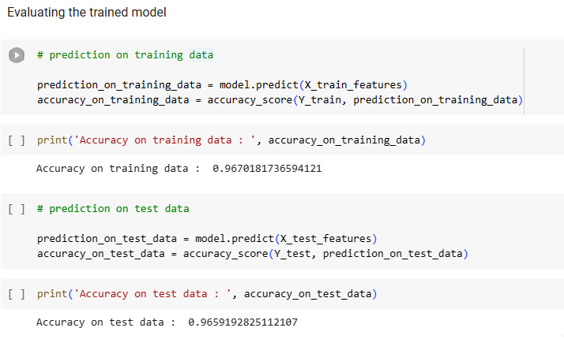


Evaluating the training model

Slide 18

Deployment and Monitoring
For the deployment of the trained Logistic Regression model using Flask, we followed the following steps:
We imported the necessary libraries, including Flask, joblib ,render_template, request. Flask is used for creating the web application, joblib for loading the trained model, render_template is used to generate output from a template file ,request object hoplds all incoming data from request,which include raw data, HTTP method etc.

Slide 19
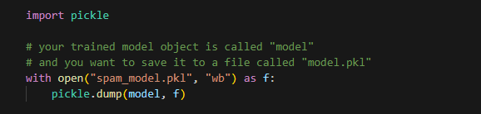
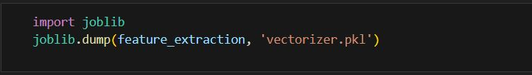

Deployment and Monitoring
We loaded the trained Logistic Regression model and Vectorizer using the joblib.load() function from the "model.pkl" file. This allowed us to convert the input mail text into numerical value and access the model for making predictions.

Slide 20
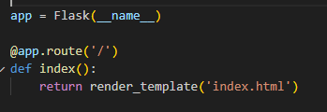
Deployment and Monitoring
We created the Flask application by initializing an instance of the Flask class and assigned it to the 'app' variable.
We defined the home route ("/") using the @app.route() decorator, which rendered the "index.html" template.

Slide 21
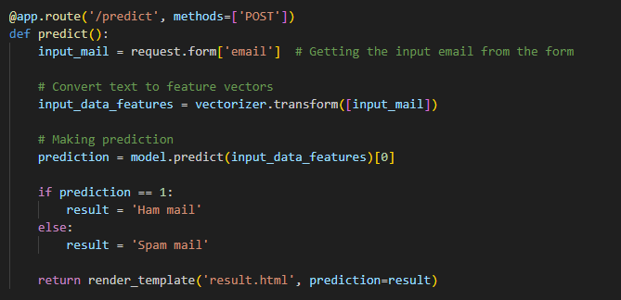
Deployment and Monitoring
We defined the predict route ("/predict") using the @app.route() decorator with the "POST" method. This route was responsible for receiving the Spam Email data through a POST request and making predictions using the trained model.

Slide 22
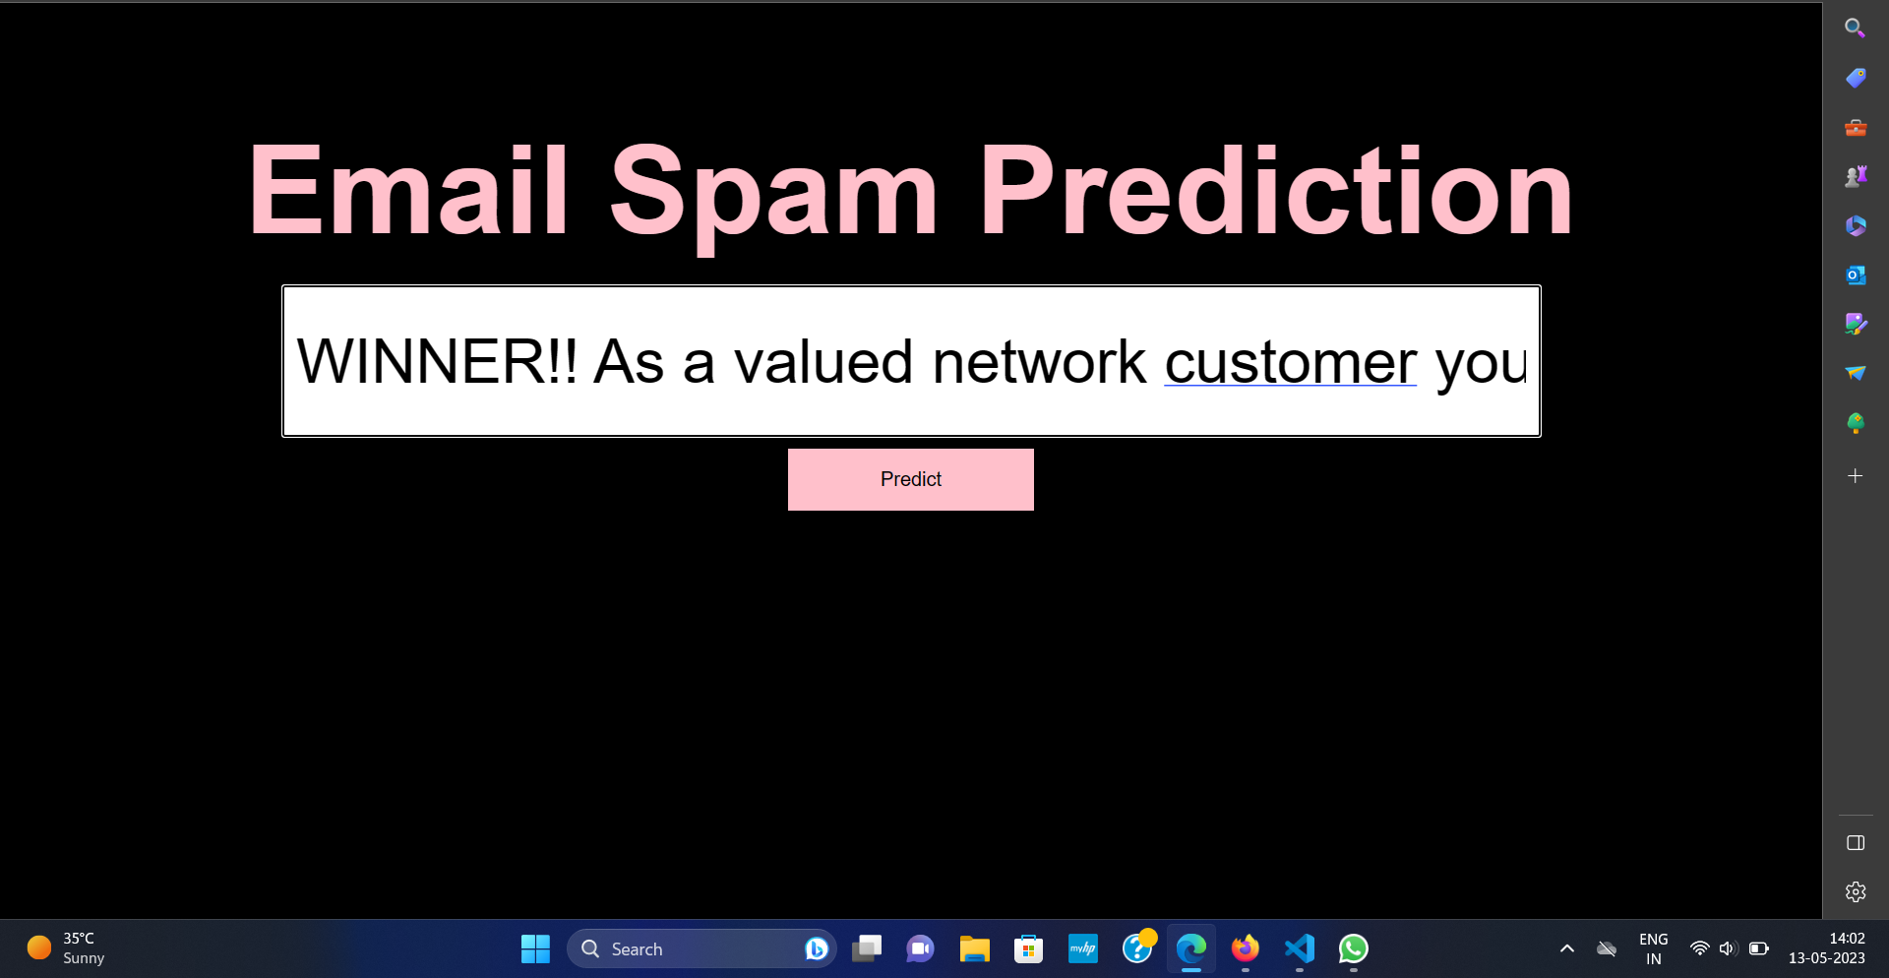
Deployment and Monitoring
After running the Flask application by executing the "flask app.py" command, a local server is created, and upon accessing the server's link in a web browser, a web page is displayed.
This web page allows users to input the required values for Spam Email data.
Once the user fills in the necessary information and clicks the "Predict" button, the input data is sent to the Flask application's "/predict" endpoint.

Slide 23
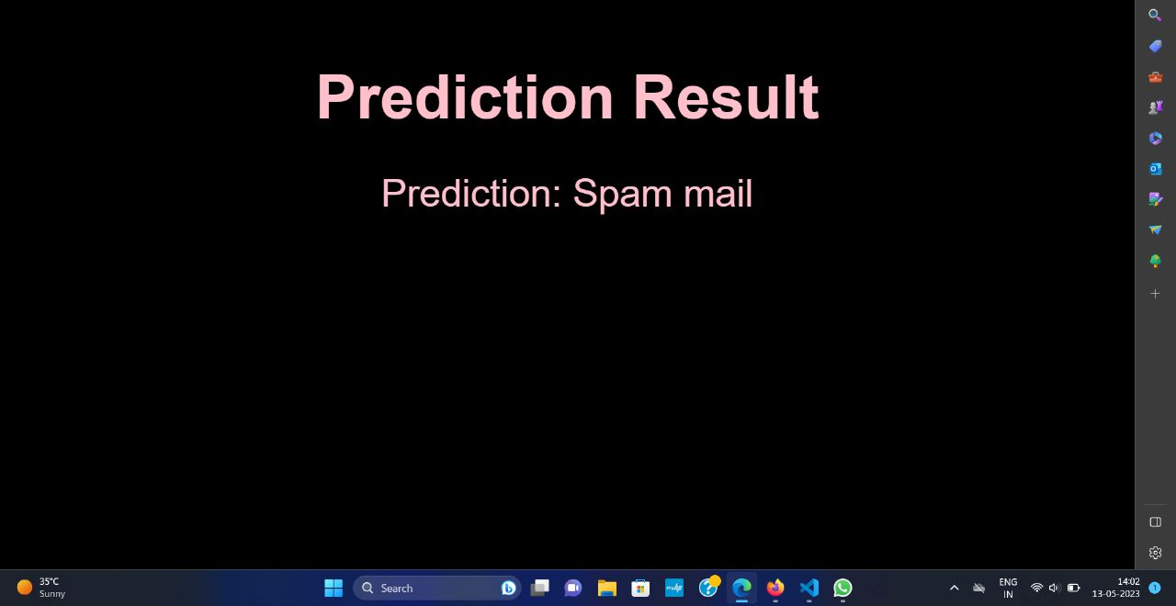
Deployment and Monitoring
The Flask application then processes the data, makes predictions using the trained Logistic Regression model, and redirects the user to the "result.html" page.
On the "result.html" page, the prediction result, indicating whether the Email is classified as Spam or Ham.

Slide 24

Conclusion
In conclusion, the Spam Email prediction project utilized machine learning techniques to address the critical issue of detecting fraudulent transactions. Throughout the project, we followed a systematic approach and implemented various steps to develop an effective solution.
We started by gathering a comprehensive dataset consisting of credit card transaction records, including both legitimate and fraudulent instances
Data preprocessing was performed to handle missing values, standardize features, and address class imbalance, ensuring the dataset's quality and reliability.
Exploratory data analysis provided valuable insights into the characteristics and patterns of fraudulent transactions, aiding in feature selection and model development.
Logistic Regression was selected as the classification algorithm due to its simplicity, interpretability, and efficiency in binary classification tasks.

Slide 25

Conclusion
The dataset was split into training and testing sets using the train-test split function, enabling us to evaluate the model's performance on unseen data.
The Logistic Regression model was trained on the training set, leveraging the data's patterns and features to learn the underlying patterns of Spam.
Model evaluation was conducted using various metrics, including accuracy, precision, recall, and F1-score, to assess the model's performance in correctly classifying Spam And Ham Emails.
Our trained model was deployed using Flask, a web framework, allowing users to interact with the model through a user-friendly web interface.
The deployment phase involved integrating the model into the Flask application, ensuring security measures, and monitoring its performance in real-time Spam Mail prediction.
Overall, this project demonstrated the successful implementation of machine learning techniques, particularly Logistic Regression, in Spam Email prediction. The developed solution provides an efficient and reliable means of identifying Spam Emails, helping peoples and organization to easily identyfying Spam Emails.

Slide 26

our office

